Slide 1
Presented by English as a Second Language and Parent & Family Engagement

Slide 2
Parent Guide to Elpt English Language Proficiency Test

Slide 3
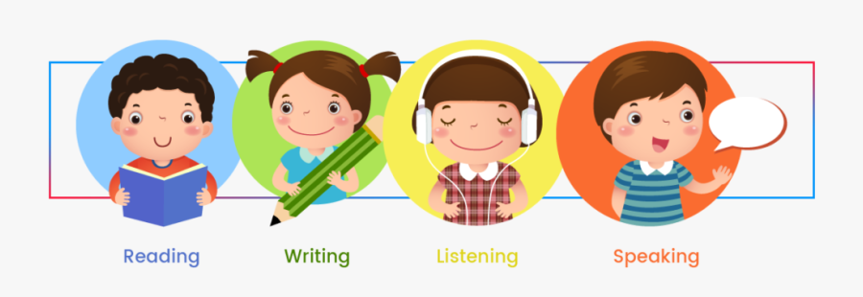
English Language Proficiency Test: ELPT
Each spring, students who have been identified as English Learners (ELs) enrolled in grades K-12 take ELPT. It measures a student’s English proficiency in the
four language domains:
Reading
Writing
Speaking
Listening

Slide 4
Understanding the Test

Slide 5
Understanding the Test
Untimed, online assessment
ELPT is designed to measure the performance of ELs as they progress through their K-12 education.

Slide 6
Understanding the Test
Results are used to determine
a student’s level of English proficiency
language services and supports the student will need to participate in core content classes.
ELPT is taken each year until students are determined to be proficient.

Slide 7
Understanding the Test
Proficiency is defined as the ability to use English to communicate ideas, knowledge, and information
Even students who have refused participation in an EL program are required to take ELPT

Slide 8
ELPT Design
ELPT consists of various performance tasks spread out across the four language domains.
Multiple-choice questions
Constructed response
Some use technology where students produce a response
The following two slides give some task types by domain.

Slide 9
Grades | READING | WRITING | SPEAKING | LISTENING
K | Literary Texts Informational texts Correspondence | Words Sentences | Classroom scenario Picture description | Matching Follow instructions Conversations
1 | Literary Texts Informational texts Correspondence | Words Sentences | Show and Share Opinion | Conversations Read aloud Presentation
2-3 | Literary Texts Informational texts Correspondence | Picture caption Storyboard | Opinion Conversation | Follow instructions Conversation Discussion
4-5 | Literary Texts Informational texts Correspondence | Editing Opinion Writing Questions | Analyze a visual Compare pictures Conversation
6-8 | Literary Texts Informational texts Correspondence | Editing Writing Question Emails | ELA presentations Analysis Observe and report
9-12 | Literary Texts Informational texts Correspondence | Editing Emails Construct a claim | Compare pictures Presentations Observe and report

Slide 10
Performance Levels
Students will receive a Performance Level score in each domain as well as an overall Proficiency Level.
PERFORMANCE LEVELS
Level 1: Beginning
Level 2: Early Intermediate
Level 3: Intermediate
Level 4: Early Advanced
Level 5: Advanced
PROFICIENCY LEVELS
Emerging
Progressing
Proficient

Slide 11
Testing Schedule

Slide 12
Testing Schedule
Online testing schedule:
Begins in early-mid February, ends in mid-late March
Schools determine the schedule for administering the online tests during this window.
Testing days and session rotations will vary by school.

Slide 13
How to Help Your Child Prepare for the Test

Slide 14
Prepare for ELPT
The LA Connectors for ELs provide descriptions of the English language skills and knowledge your child should have based on his/her domain performance level.
LA Connectors for ELs

Slide 15
Prepare for ELPT
Other ways to help your child include:
Have your child read to you (or a younger sibling)
Visit your local library and borrow audiobooks
Attend parent-teacher conferences at your child’s school
Watch television or listen to music in English
Practice reading and writing in your native language as well (research shows that doing so helps to support English literacy skills)

Slide 16
Prepare for ELPT
By understanding the language skills your student needs to be proficient, you will be better positioned to help your child connect the dots between what he/she is learning and the assessment

Slide 17
Student ELPT results

Slide 18
Student ELPT Results
Schools receive results in May
The results will include the Domain Performance Level as well as the Overall Proficiency Level.
View the Parent Guide to the ELPT Student Reports to learn more.

Slide 19
Useful links

Slide 20
Useful Links
ELPT Online Tools Training
Parent Guide to ELPT Student Reports (English)
Parent Guide to ELPT Student Reports (Arabic)
Parent Guide to ELPT Student Reports (Spanish)
Parent Guide to ELPT Student Reports (Vietnamese)
LDOE Family Support Toolbox Library

