Slide 1
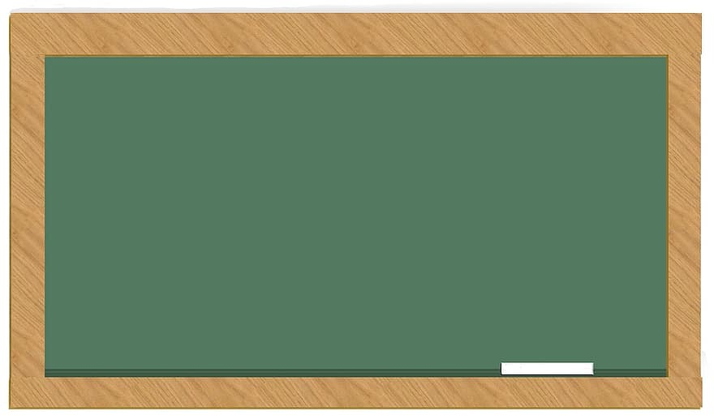
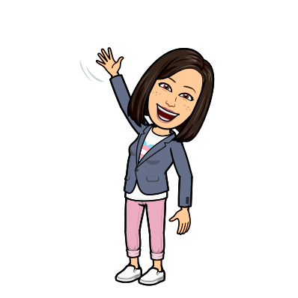
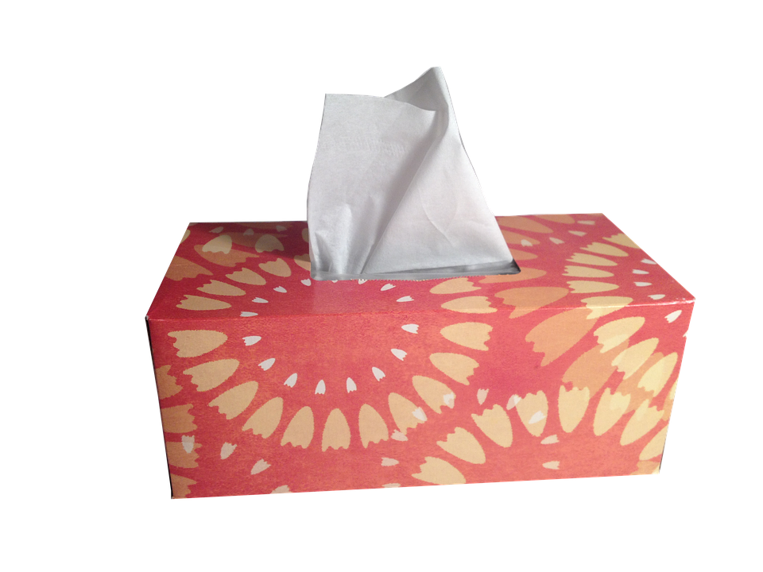
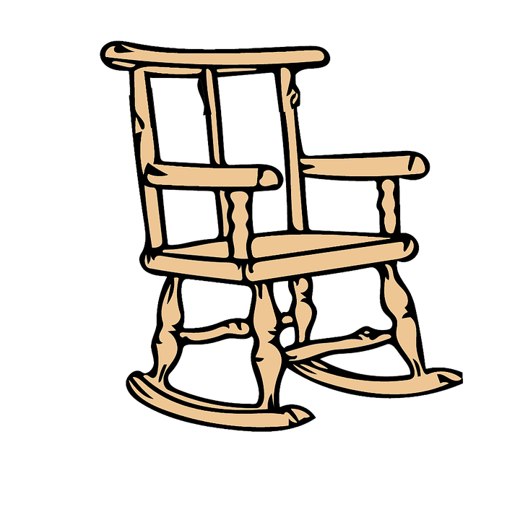
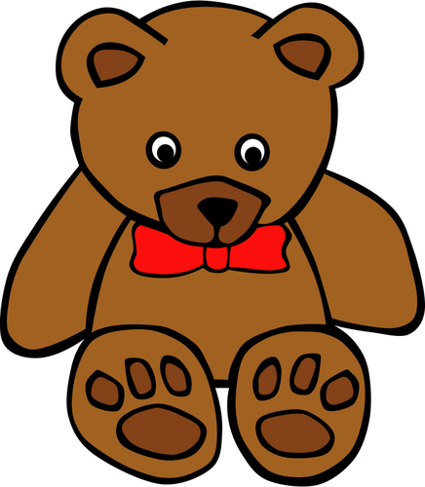
GTL Counselors
Welcome You to a New School Year
Mrs. Louis
Mrs. Manuel

Slide 2
Our Mission Statement
It is the mission of the G.T. Lindon counseling department to provide students with a counseling program that will develop awareness, knowledge, and growth in the areas of academics, careers, and social/personal living so that they function successfully in society as adults.

Slide 3
Responsive Services
Individual and small group counseling
Individual / family / school crisis intervention
Classroom instruction
Referrals
Consultation / collaboration

Slide 4
School Guidance Curriculum
Academic support (organizational, study and test-taking skills)
Career awareness
Understanding self and others
Peer relationships, coping strategies, social skills
Problem-solving and conflict resolution
Individual student planning

Slide 5
Parent Resources
Tips for a Successful School Year
Managing Homework Time
Building Positive Self-Esteem in Your Child
Taking Care of Yourself

Slide 6
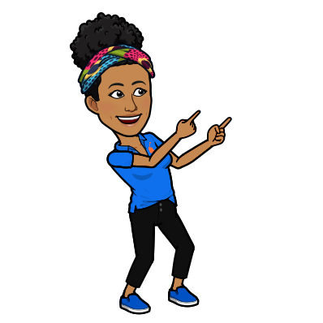
We’re here to help your child set sail for success!

